Slide 1
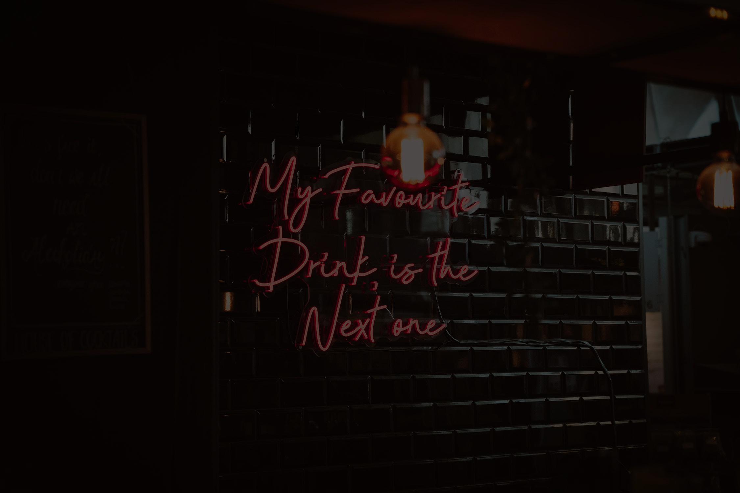

ANALYSIS of BARS
ANALYSIS of BARS
STAT 628 Module 3
Group 4
Abigail Terzis
Samach Sathitvudh
Jianzhuo Liu

Slide 2
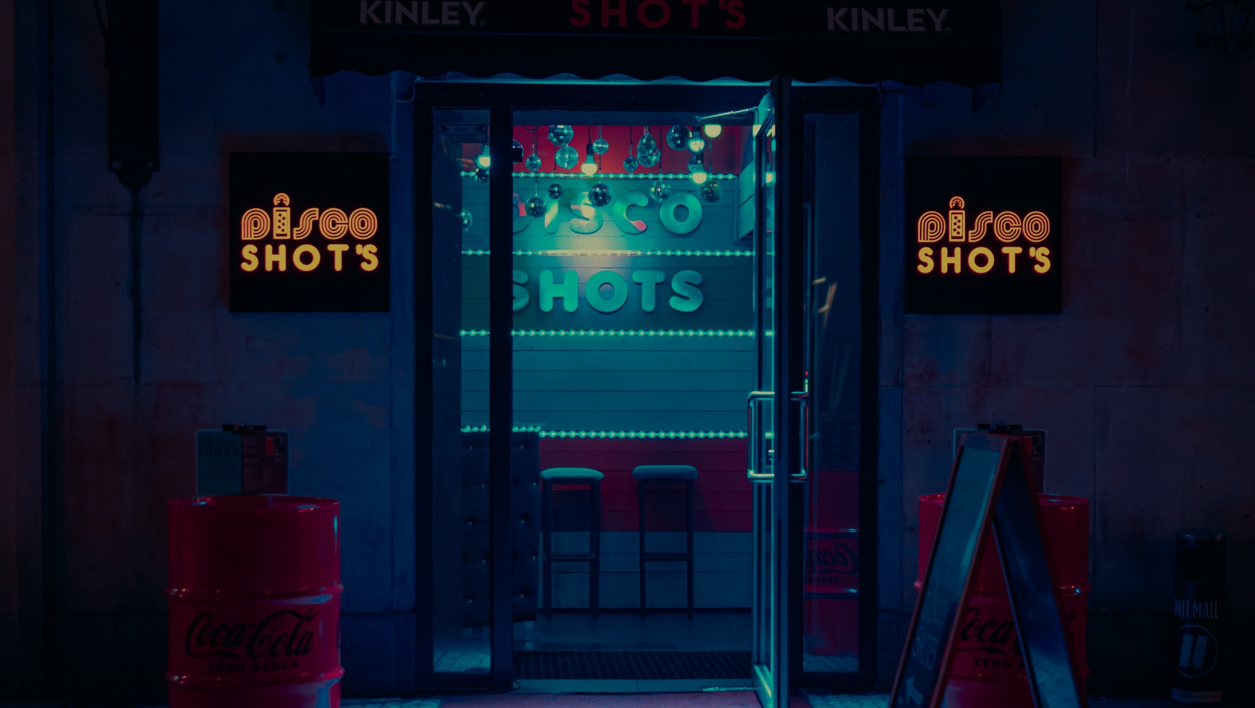
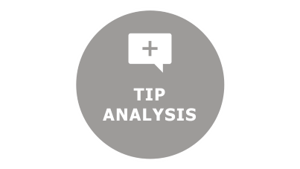

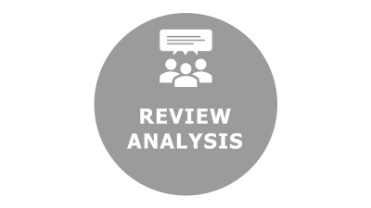
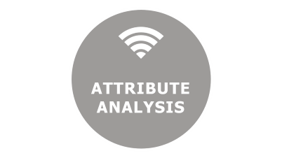


Slide 3

BACKGROUND
&
RECAP

Slide 4
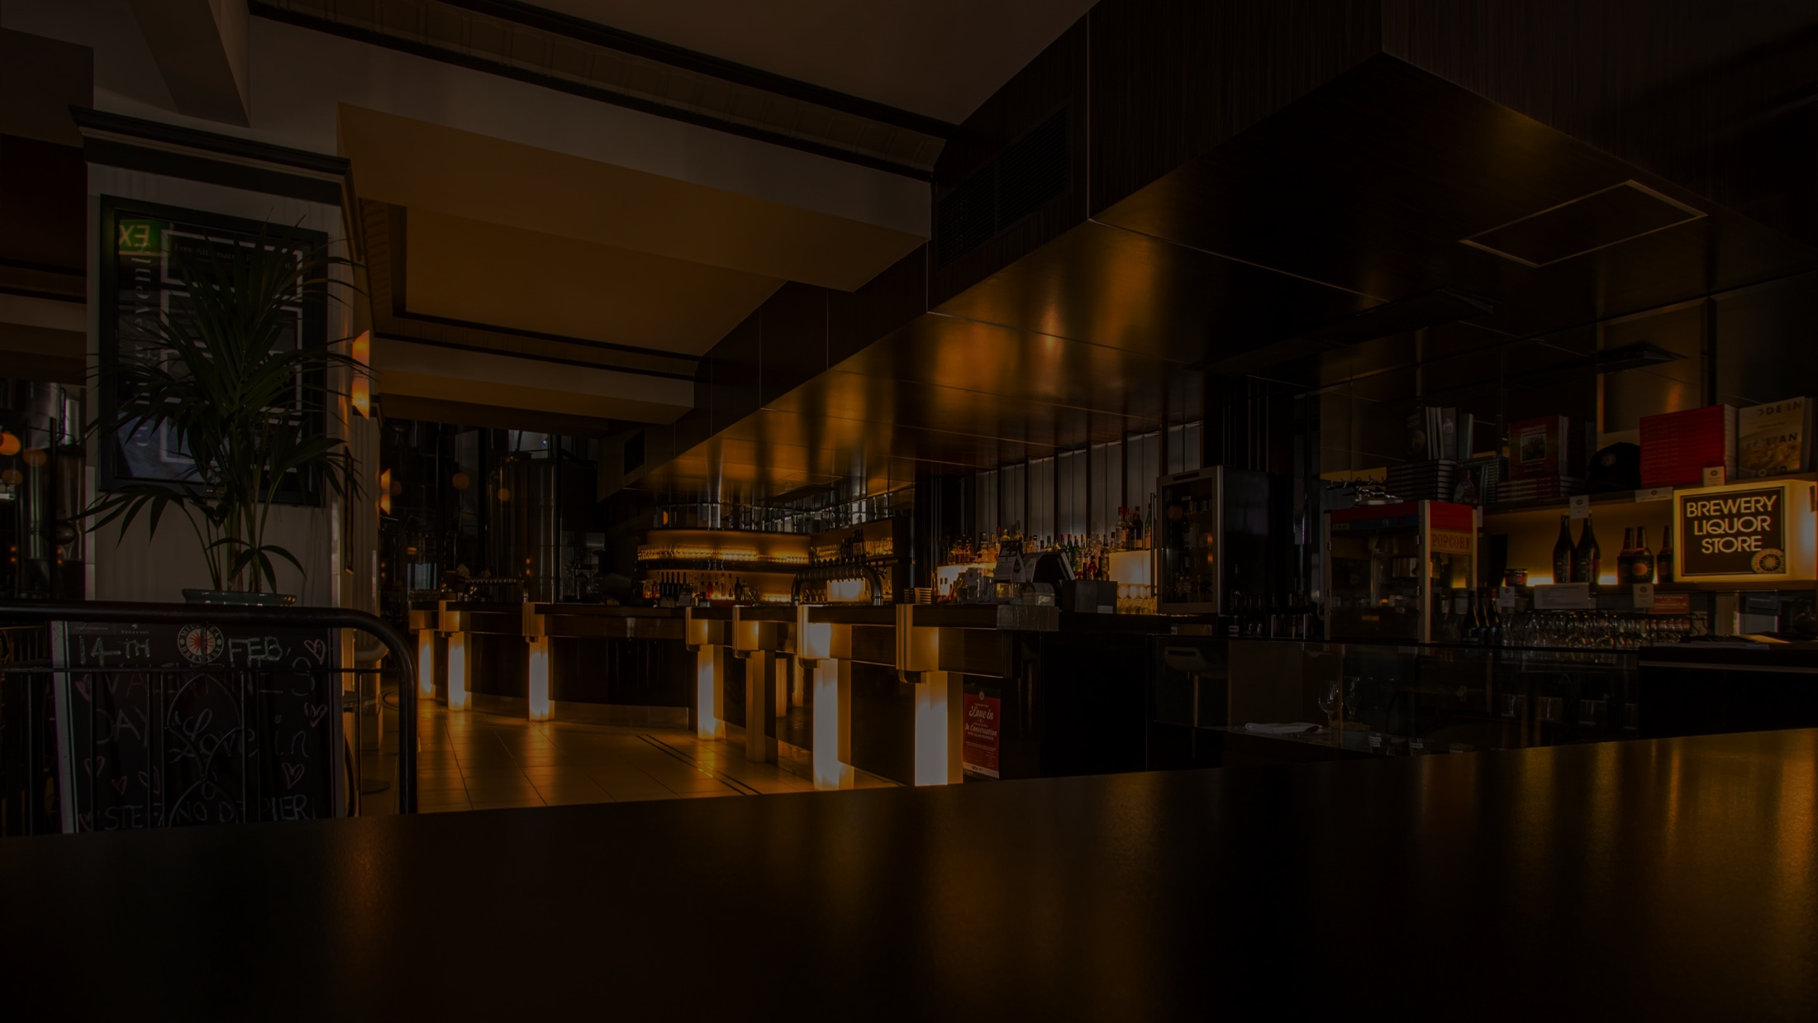
Questions of Interest
1. What makes a bar successful among others ?
2. How could a bar owner do to improve
their business ?

Slide 5




Scope of Analysis
Offer alcohols
(Wine, Whiskey, Beer)
163 Bars in CA
44,693 reviews
4,612 tips given

Slide 6






What do we analyze?
Review
Natural Language Processing
Sentiment Analysis
Tip
Attribute
Rating prediction model

Slide 7






What do we analyze?
Review
Natural Language Processing
Sentiment Analysis
Tip
Attribute
Rating prediction model

Slide 8
ATTRIBUTE
ANALYSIS

Slide 9
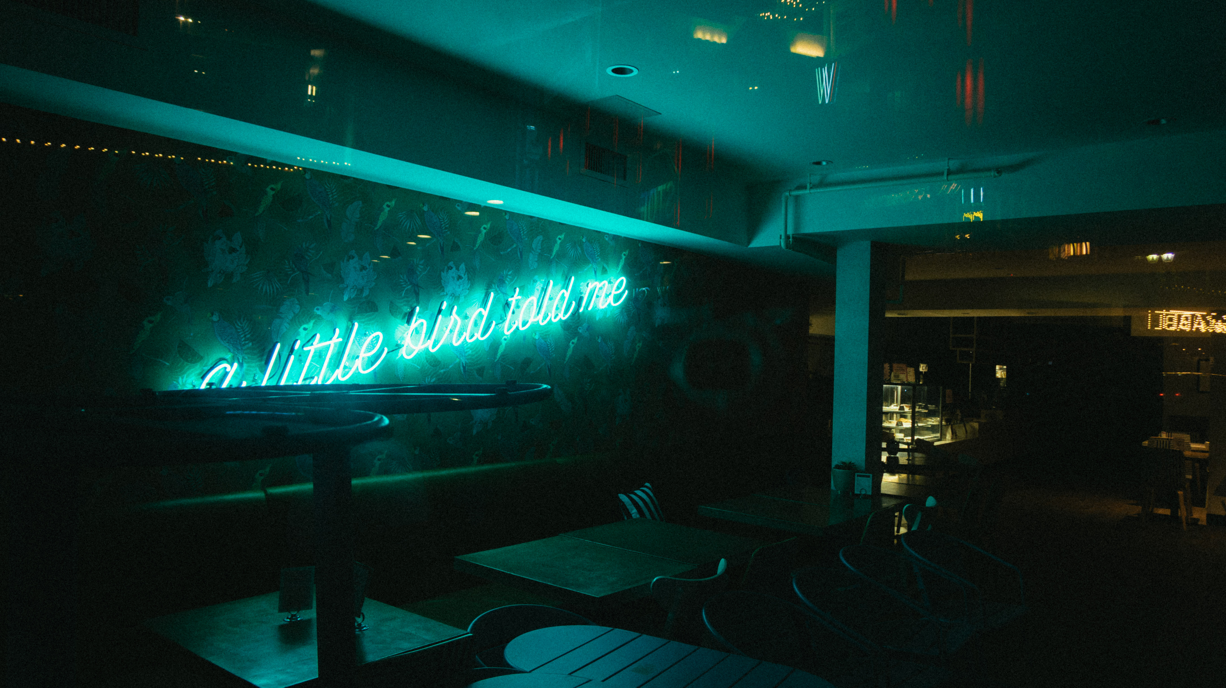
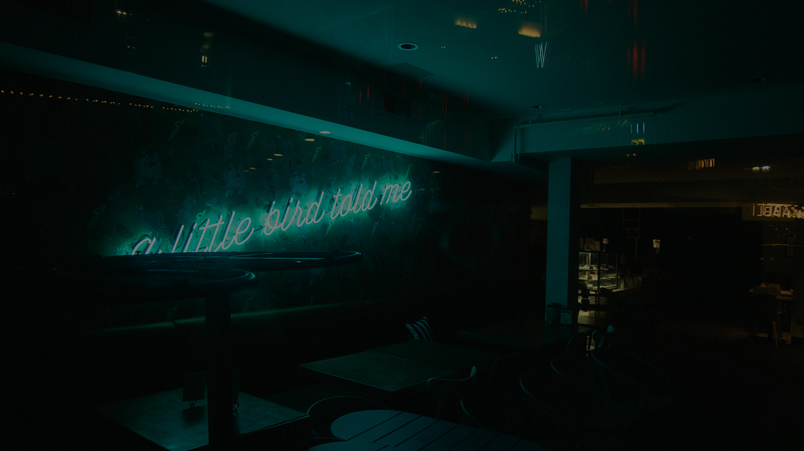
OBJECTIVES
1. To show see which attribute might affect ratings
2. To fit the model for rating predictions
3. To suggest bar owners some advice
based on the model

Slide 10
KEY TAKEAWAY recap
Most reviews give 5-star ratings.
Most bars have free WIFI.
Full bar is more popular among others

Slide 11



RATING MODEL
y
log y
ANOVA
Fit the full
linear model
of attributes
Used ANOVA
and add
interaction terms
Log transformation

Slide 12

RATING MODEL
$$Rating \\ \text{= }1.48+0.08 Validated −0.08 Lunch −0.07Alcohol −0.15 Hipster \\ −0.16\left(Valet∗Lunch\right)−0.18\left(Touristy∗Karaoke\right)+0.16\left(Touristy∗Alcohol\right) \\ +0.14\left(Intimate∗Hipster\right)−0.17\left(Intimate∗Street\right)+0.1\left(Lunch ∗Hipster\right) \\ +0.09(Lunch∗Alcohol)$$

Slide 13
MODEL PROs and CONs
Cross-over
interaction
Significant coef.
Fairly acceptable
R-square
Might have a
better model

Slide 14
REVIEW
ANALYSIS

Slide 15
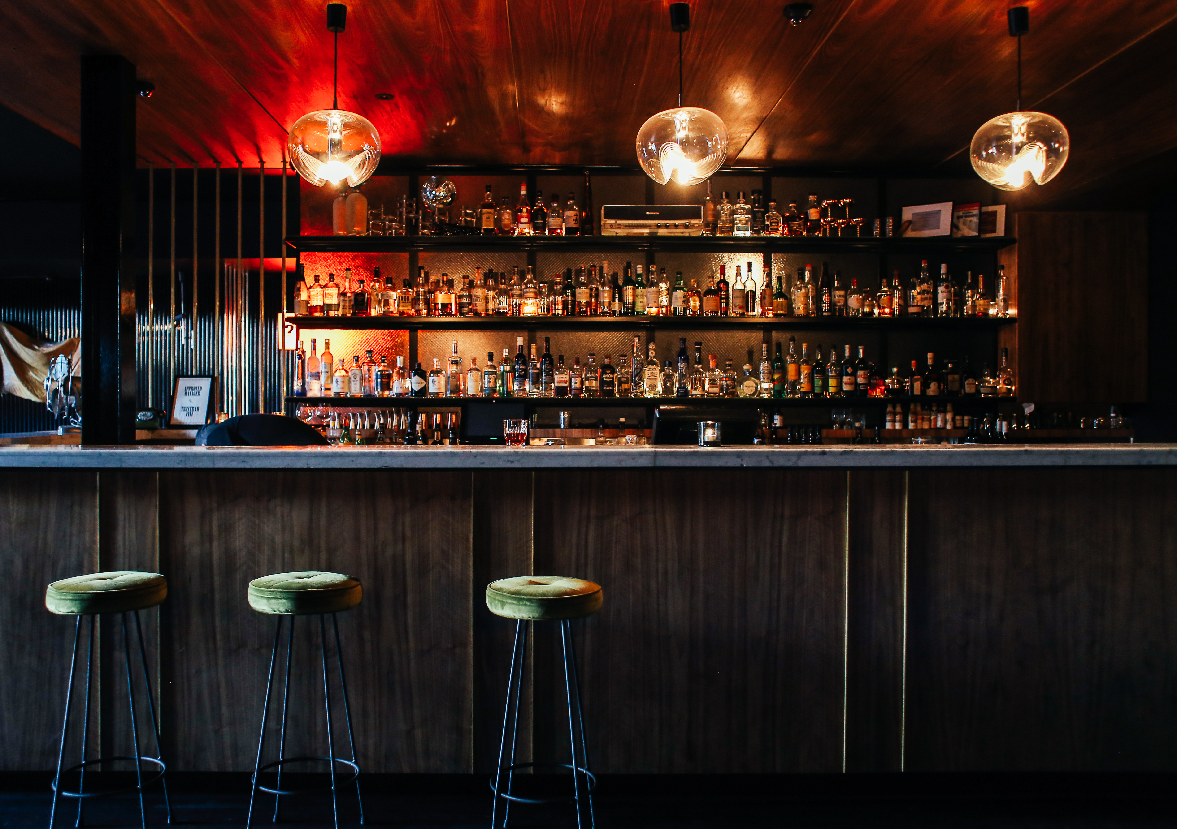
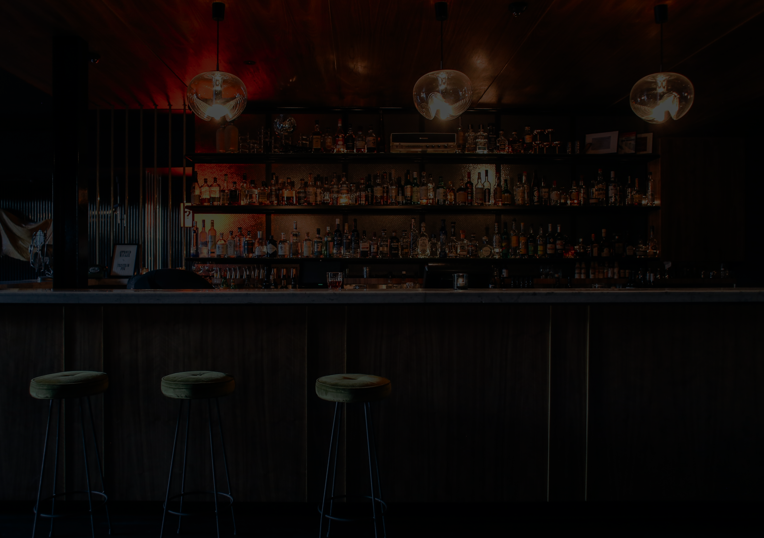
OBJECTIVES
1. To give bar owners an overview of their businesses
2. To show their most mentioned features
3. To analyze the customer’s sentiments

Slide 16
KEY TAKEAWAYS recap
Most people have positive perspectives about bars
Wine and service have the highest mentions in review
Most negative reviews are related to table and ordering

Slide 17




Analysis
Procedures

Slide 18

TOP FIVE MENTIONS
Overall
WINE
STAFF
DRINK
TABLE
BEER
Example from one bar
BEER
TIME
OWNER
CRUISERY
CHICKEN

Slide 19




SENTIMENT SCORE
Classify positivity
and negativity
of adjectives
Obtain useful
nouns for
prediction
Evaluate
sentiment score

Slide 20




SENTIMENT SCORE
Classify positivity
and negativity
of adjectives
Obtain useful
nouns for
prediction
Evaluate
sentiment score

Slide 21

SENTIMENT SCORE
n_Positive
100 x
n_Positive + n_Negative
Classify positivity
and negativity
of adjectives
Obtain useful
nouns for
prediction
Evaluate
sentiment score

Slide 22
SENTIMENT SCORE
Z
Z
FOOD
DRINK
1
2
3
4
5
6
7
8
9
0
0
1
2
3
4
5
6
7
8
9
0
1
2
3
4
5
6
7
8
9
0
0
1
2
3
4
5
6
7
8
9
0

Slide 23
SENTIMENT SCORE
Z
Z
WINE
WAITER
1
2
3
4
5
6
7
8
9
0
0
1
2
3
4
5
6
7
8
9
0
1
2
3
4
5
6
7
8
9
0
0
1
2
3
4
5
6
7
8
9
0

Slide 24


CORRELATION TEST
Some keywords are positively correlated with the ratings
Food Drink Service Burger
Beer Staff Table Waiter
$$α=0.05$$

Slide 25
TIP
ANALYSIS

Slide 26
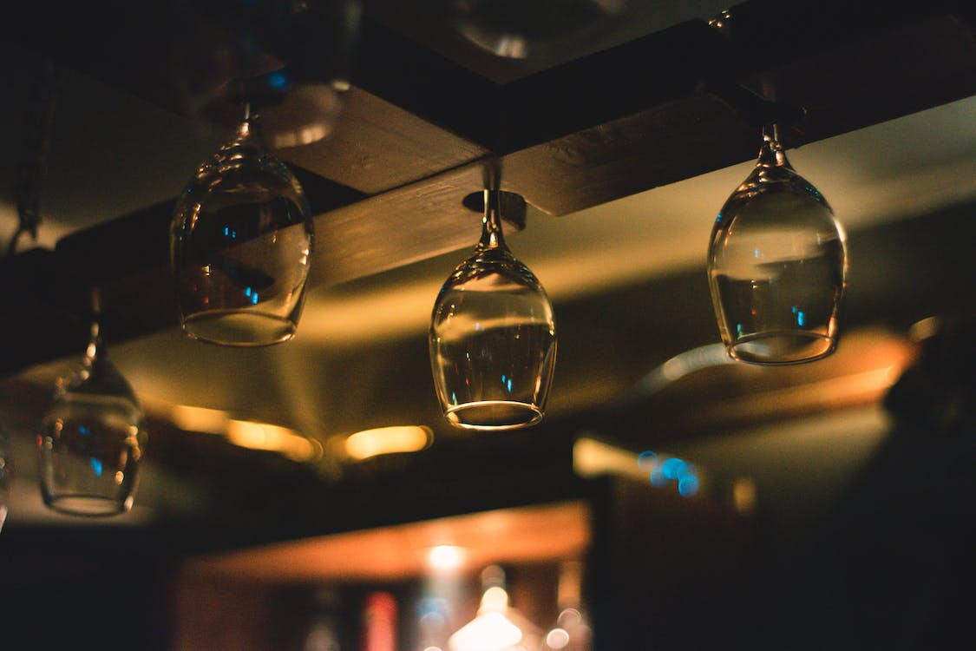
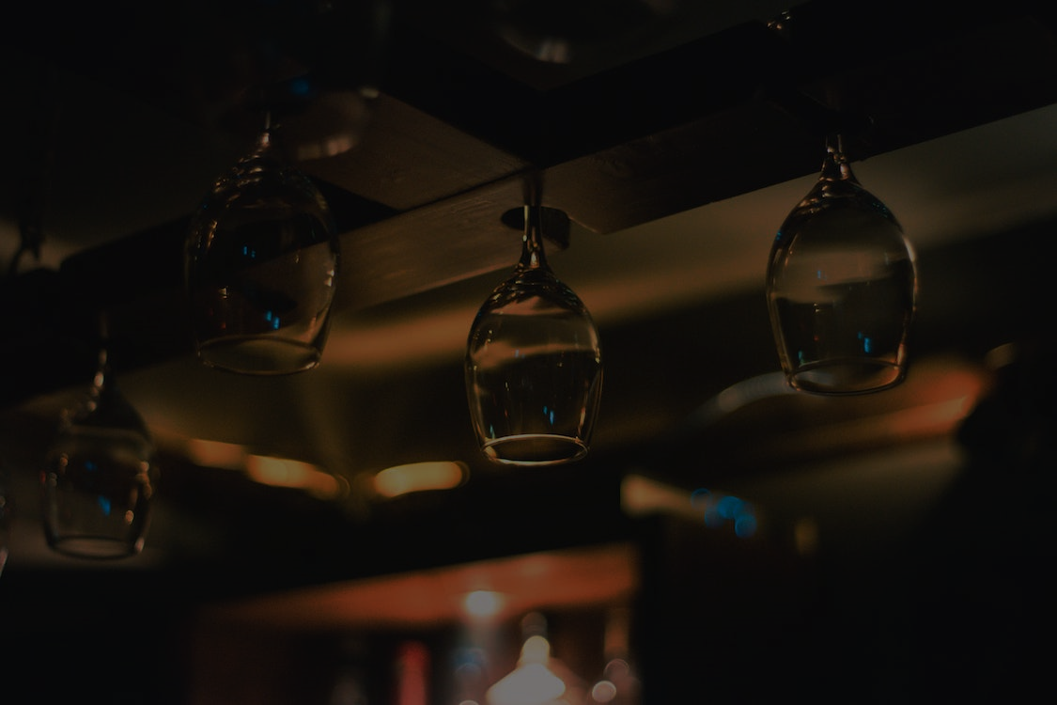
OBJECTIVES
EDA for TIP DATA
1. To analyze customer’s suggestions
2. To analyze bigrams of tips

Slide 27
KEY TAKEAWAYS recap
EDA for TIP DATA
Most people are still positive if they give the bar tips
Happy hours could be necessary for bars
We expect to see high positive sentiment

Slide 28



BIGRAMS MOTIVATION
EDA for TIP DATA
Focus on
positive feedback
Use tf-idf to
quantify the relevance
Keep bigrams
for high rating

Slide 29
Baked clams
Garlic baked
Chicken piccata
Lobster bisque
French toast
Crab special
Rock crab
Free calamari
tf-idf

Slide 30
Bo henrys
Sand dabs
Oyster bar
Hickory burger
Charbroiled oys
Sweet potato
Grilled fish
Excellent beer
tf-idf

Slide 31
Takeout special
Socialize soc
Italian wine
Cozy jem
Cozy friendly
Coolest concert
Concert posted
Closed Monday
tf-idf

Slide 32

DISCUSSION

Slide 33


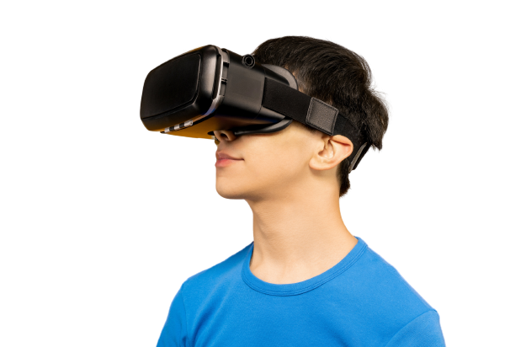
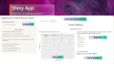
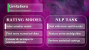
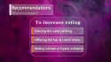
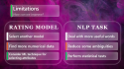

DISCUSSION
SECTIONS
Recommendations
What do we suggest?
Shiny App
App for business owner
Limitations
How can we improve?

Slide 34
Recommendations
What do we suggest?
To increase rating
Owning the valet parking
Offering full bar & Lunch menu
App for business owner
How can we improve?
Making intimate or hipster ambience

Slide 35
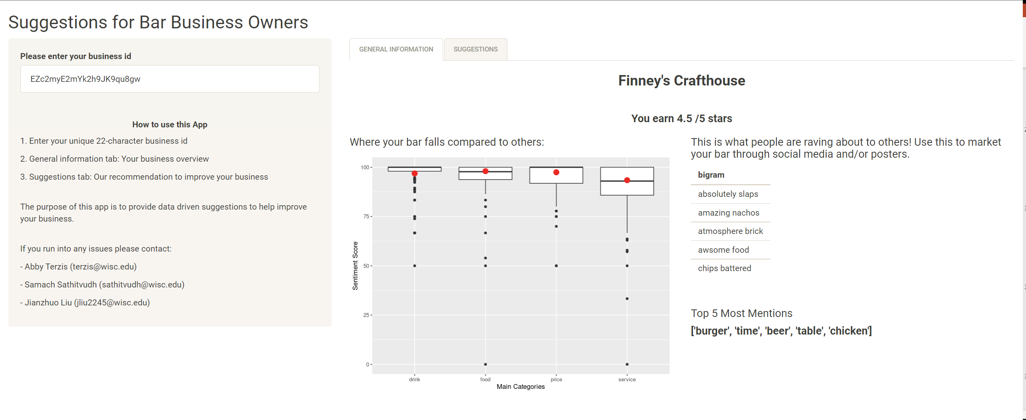
Shiny App
App for business owner
General Information
instruction
Bigrams
Box plot
Top 5 words

Slide 36
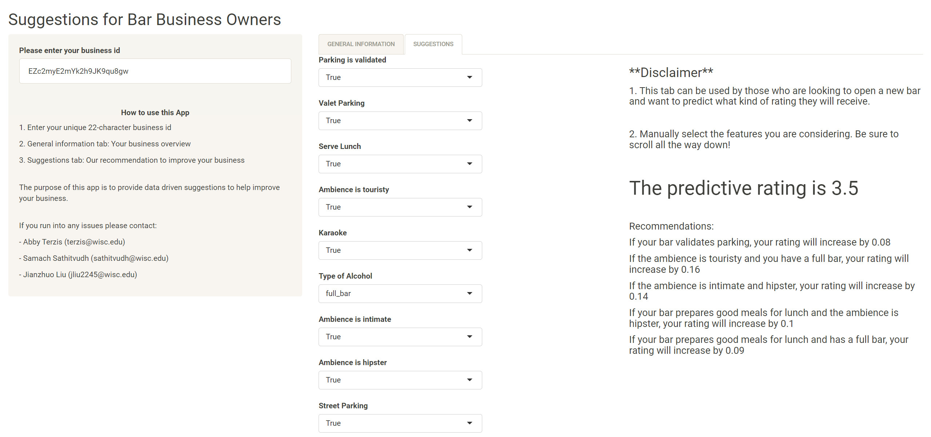
Shiny App
App for business owner
Suggestions for current/new bar owners
Input attributes
Detailed recommendation

Slide 37
Limitations
How can we improve?
RATING MODEL
NLP TASK
Select another model
Deal with more useful words
Find more numerical data
Reduce some ambiguities
Consider ML technique for selecting attributes
Perform statistical tests

